Slide 1

CLUSTERING-BASED COLOR TRANSFER AND HARMONY ADJUSTMENT
FOR IMAGE AND VIDEO AESTHETIC ENHANCEMENT
Presented By : Team Mobiuz
IIIT Hyderabad | DIP 2024

Slide 2
1
ABSTRACT
This work integrates artistic color theory with computational methods to enhance image and video aesthetics. It uses k-means clustering to extract dominant palettes, Radial Basis Function (RBF) weights for smooth color mapping, and harmony shifts guided by Brent’s optimization for perceptual balance. The framework supports style-driven color transfer and harmony adjustments, advancing tools for digital design and cinematography.
IIIT Hyderabad | DIP 2024

Slide 3
2
OVERVIEW
Introduction
Literary Review
Conclusion
Problem
Methodology
Limitations
Objectives
Results
Future directions
References
IIIT Hyderabad | DIP 2024

Slide 4
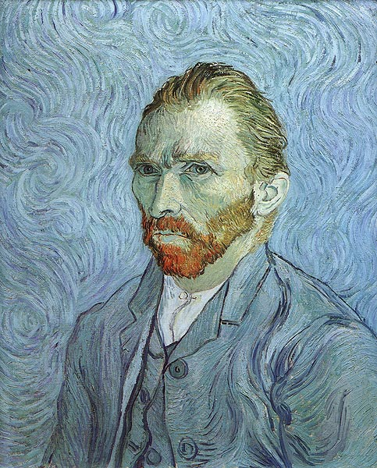
3
INTRODUCTION
The interplay of colors significantly influences the aesthetic appeal and emotional impact of images and videos.
Color theory and the principles of color harmony have been a cornerstone of artistic endeavors for centuries, guiding the creation of visually pleasing compositions.
IIIT Hyderabad | DIP 2024

Slide 5
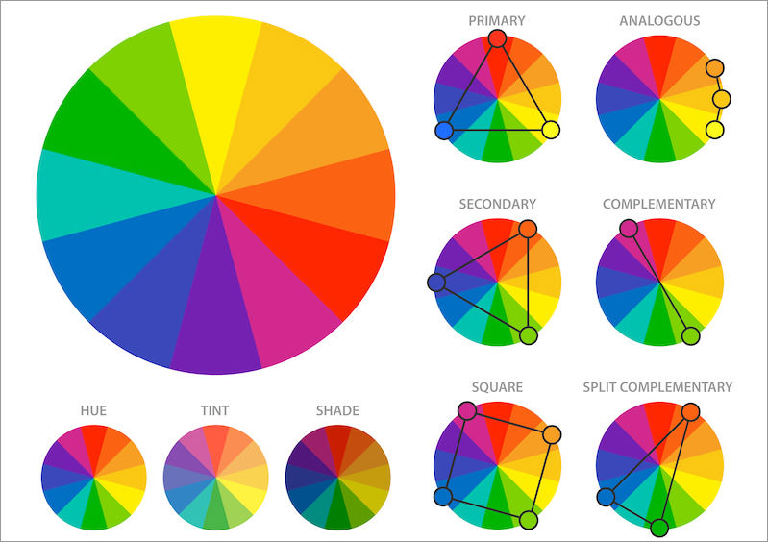
4
INTRODUCTION
In modern digital media, the need for tools that can intelligently apply these principles is more pressing than ever.
Creators seek ways to enhance the visual quality of content for diverse applications such as advertising, cinematography, and social media.
IIIT Hyderabad | DIP 2024

Slide 6
5
OBJECTIVES
Color Harmonization
This project presents a novel computational framework that integrates color harmony principles with automated color transfer techniques to enhance the aesthetics of both images and videos.
Color harmony refers to the arrangement of colors in a way that is perceived as pleasing or balanced. Complementary, analogous, and triadic, etc.
IIIT Hyderabad | DIP 2024
Color transfer
Style transfer has emerged as a powerful technique in computer vision for applying the color and texture characteristics of one image to another image.

Slide 7
6
LITERARY REVIEW
1
Traditionally, artists choose a harmonic set from prescribed sets provided in handbooks [2]. Later on efforts were made to create interactive applications [3].
Once the set is defined, the artist needs to color or recolor his/her product with this set, a task that can be tedious when the image is complex and contains many colors.
IIIT Hyderabad | DIP 2024
Some efforts have been made in creating automated tools that let users recolor a photograph [4]. However, all of these rely on the user to make sensible choices to maintain color harmony to some extent. And they are single image tools, which means that recoloring one image based on other is a tedious task.
2
3
With regards to style transfer, most methods focus on replicating texture or artistic patterns. Though, artistic recoloring remains a domain with a lot more potential.

Slide 8
7
LITERARY REVIEW
4
Harmony types are defined by the geometric relationships between colors in a color space, represented as angles in the hue-saturation-value (HSV) or similar spaces [1].
5
Brent’s method, a robust optimization technique, is employed to identify the optimal parameters for applying color harmony to any given visual input [6] [7].
IIIT Hyderabad | DIP 2024
6
This mapping is performed using Radial Basis Function (RBF) weights, ensuring smooth and natural transitions between colors [5]. RBF weights are computed using Gaussian functions centered around the style palette colors.
7
The notion of color harmony in our work is based on the schemes developed by Matsuda [11] [12], which descend from Itten’s notions of harmony [13] [14], widely accepted in applicable fields involving colors.

Slide 9
8
METHODOLOGY
Overview
Color Palette Extraction Using K-Means Clustering
Color Transfer Using RBF Mapping
Harmonic Shift Adjustment
Temporal Coherence for Video Processing
Implementation and Modular Design
IIIT Hyderabad | DIP 2024

Slide 10
9
COLOR PALETTE EXTRACTION
Clustering Algorithm: K-means clustering is employed to identify the dominant colors in the source and style images. The images are transformed into LAB color space to better capture perceptual differences. [8] [9] [10]
The clustering process partitions the image into k clusters, where k is a predefined number representing the dominant colors.
The centroids of these clusters represent the dominant colors, forming the respective palettes for the source and style images.
Color Matching: The original image palette is mapped to the reference image palette. This mapping ensures that the original image adopts the reference image’s color scheme in a perceptually meaningful manner.
IIIT Hyderabad | DIP 2024

Slide 11
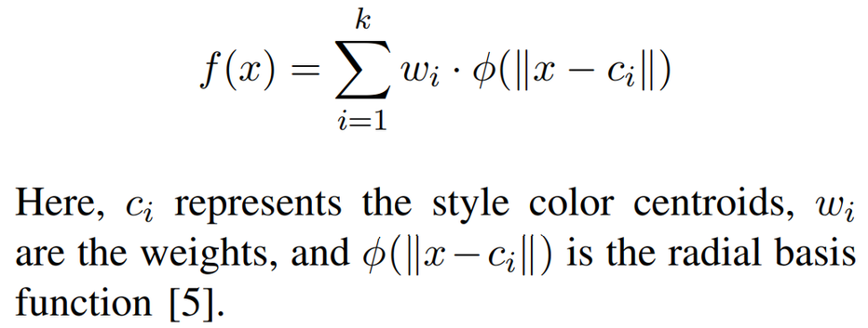
10
COLOR TRANSFER USING RBF MAPPING
Once the palettes are extracted, the next step is to transfer the colors from the style palette to the source image. Radial Basis Functions (RBFs) are used to ensure smooth transitions and natural blending.
The weights are computed using Gaussian functions centered around the style palette colors:
Application to Pixels: Each pixel in the source image is remapped to a new color using the weighted function. This ensures a seamless and perceptually consistent transfer of the style image’s color scheme.
IIIT Hyderabad | DIP 2024

Slide 12
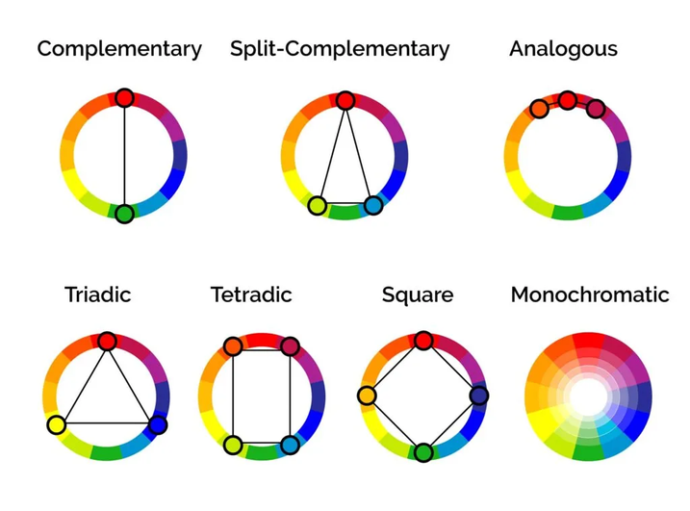
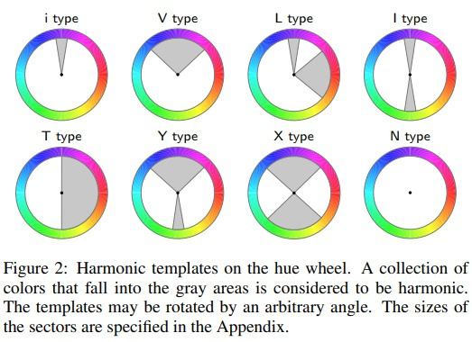
11
HARMONIC SHIFT ADJUSTMENT
To enhance the aesthetic appeal, the transferred colors are aligned with a predefined color harmony type. This process involves adjusting the hues while maintaining the perceived luminance and saturation.
Harmony Types: Harmony types are defined geometrically in the hue-saturation plane of the color space [15]. For instance:
Complementary: Colors are 180° apart in the hue circle.
Analogous: Colors are adjacent within a 30°- 60° range.
Triadic: Colors form a triangle with 120° separation.
IIIT Hyderabad | DIP 2024
[4] Cohen et. al.

Slide 13
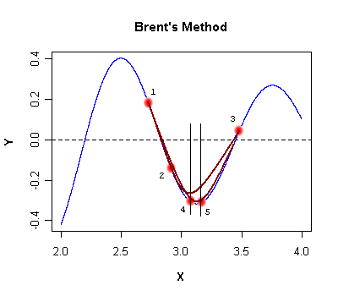
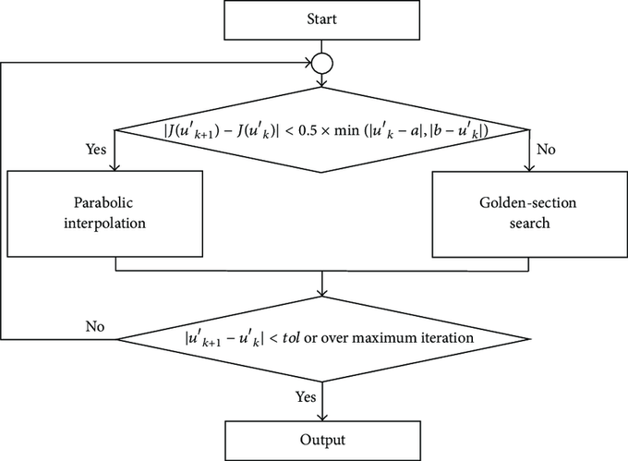
12
HARMONIC SHIFT ADJUSTMENT
Hue Adjustment: A harmonic shift is applied to the hues of the mapped colors to align them with the chosen harmony type. The adjustment is parameterized as a function of angular shifts in the hue circle.
Optimization Using Brent’s Method: Brent’s optimization algorithm is employed to minimize the perceptual error between the original and adjusted hues while maximizing adherence to the harmonic constraints. This ensures the harmonic alignment is both aesthetically pleasing and perceptually plausible.
IIIT Hyderabad | DIP 2024

Slide 14
13
TEMPORAL COHERENCE FOR VIDEO PROCESSING
For videos, maintaining temporal coherence is essential to avoid flickering or abrupt changes between frames.
Frame-by-Frame Processing: Each frame of the video is treated as an individual image during the color transfer and harmonic alignment stages.
IIIT Hyderabad | DIP 2024
Temporal Smoothing: To ensure smooth transitions, the system applies temporal smoothing to the mapped color parameters. This is achieved by:
Calculating inter-frame differences in color values.
Applying a weighted moving average filter to smooth out abrupt changes.
Optimization for Coherence: A cost function is defined to penalize large deviations in color mappings between consecutive frames. This cost is minimized using gradient-based methods, ensuring consistency across the video.

Slide 15
14
OPTIMIZATION FOR COHERENCE
The entire framework is implemented in a modular manner to allow flexibility and extensibility. Key components include:
Preprocessing Module: Converts input images and videos to the chosen color space.
IIIT Hyderabad | DIP 2024
Clustering Module: Performs k-means clustering for palette extraction.
RBF Mapping Module: Handles the computation and application of radial basis functions.
Harmonic Adjustment Module: Implements harmonic shifts and optimization.
Postprocessing Module: Converts the results back to the original color space and formats.

Slide 16
15
RESULTS AND DISCUSSION
Color Harmonization
Color Transfer
Video color grading
IIIT Hyderabad | DIP 2024

Slide 17
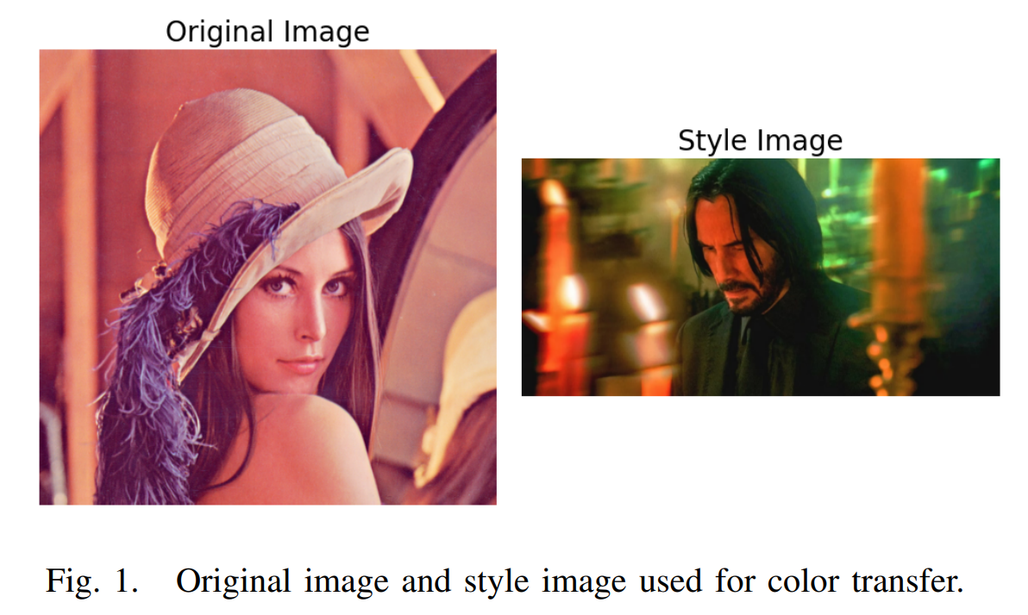
16
COLOR TRANSFER: SOURCE AND STYLE IMAGE
The first experiment demonstrates the transfer of the color palette from a style image to a source image. Figure 1 shows the input source image and the corresponding style image.
IIIT Hyderabad | DIP 2024

Slide 18
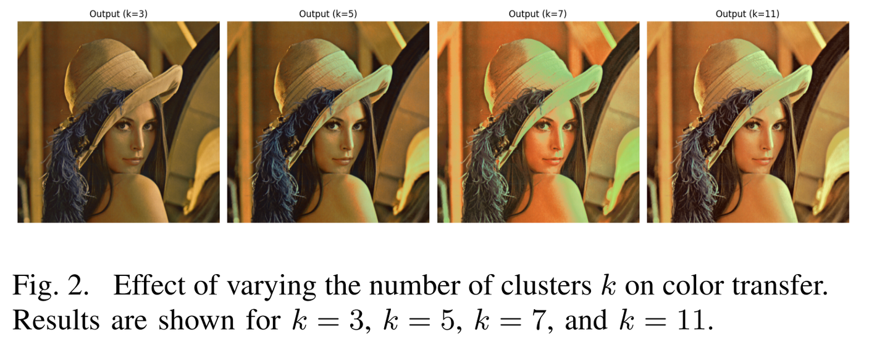
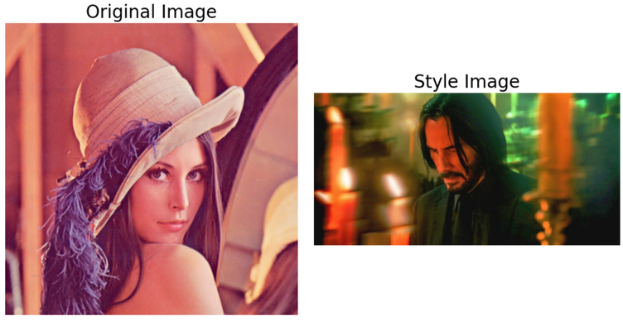
17
COLOR TRANSFER: SOURCE AND STYLE IMAGE
To evaluate the impact of the number of clusters k on the output, we varied k across values 3, 5, 7, and 11:
IIIT Hyderabad | DIP 2024

Slide 19
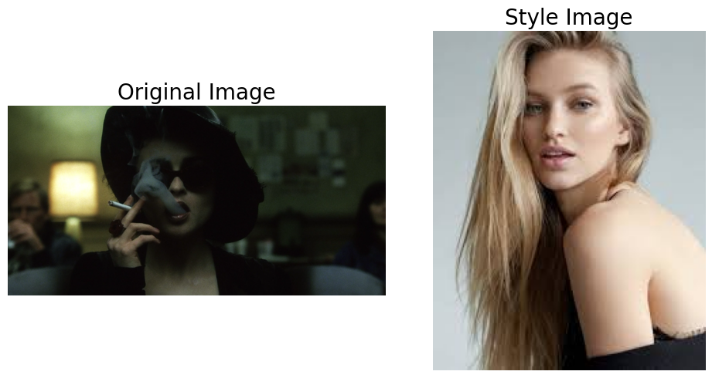
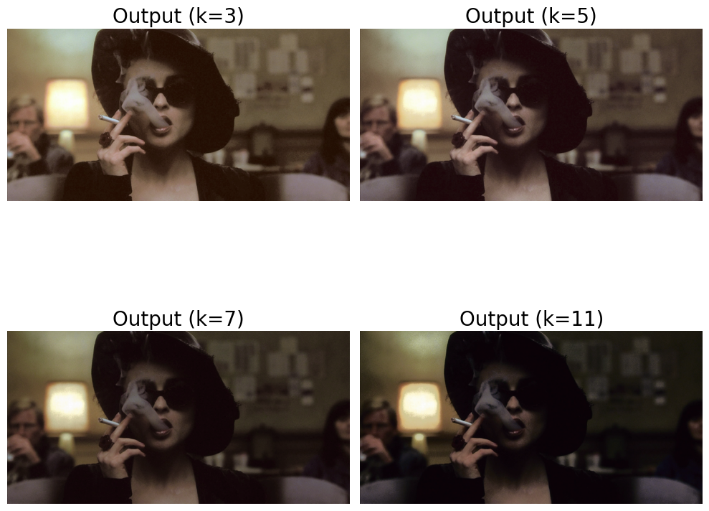
18
COLOR TRANSFER: SOURCE AND STYLE IMAGE
IIIT Hyderabad | DIP 2024

Slide 20
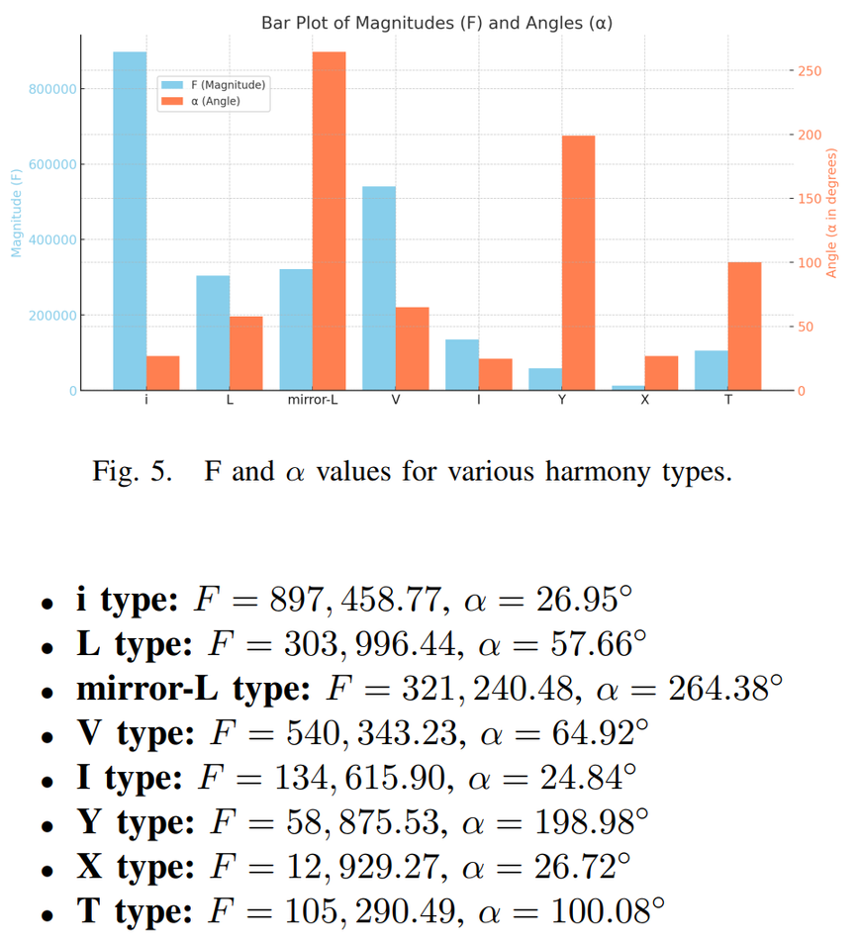
19
COLOR TRANSFER: SOURCE AND STYLE IMAGE
Steps to calculate F:
Determine the best-fit harmonic template Tm and its orientation alpha.
For each pixel:
Compute the distance to the nearest harmonic sector.
Weight this distance by the pixel’s saturation.
Sum these weighted distances for all pixels in the image.
IIIT Hyderabad | DIP 2024
What does F represent?
A smaller F means better harmony (image colors closely match the template).
A larger F indicates poor harmony (colors are far from the harmonic template).

Slide 21
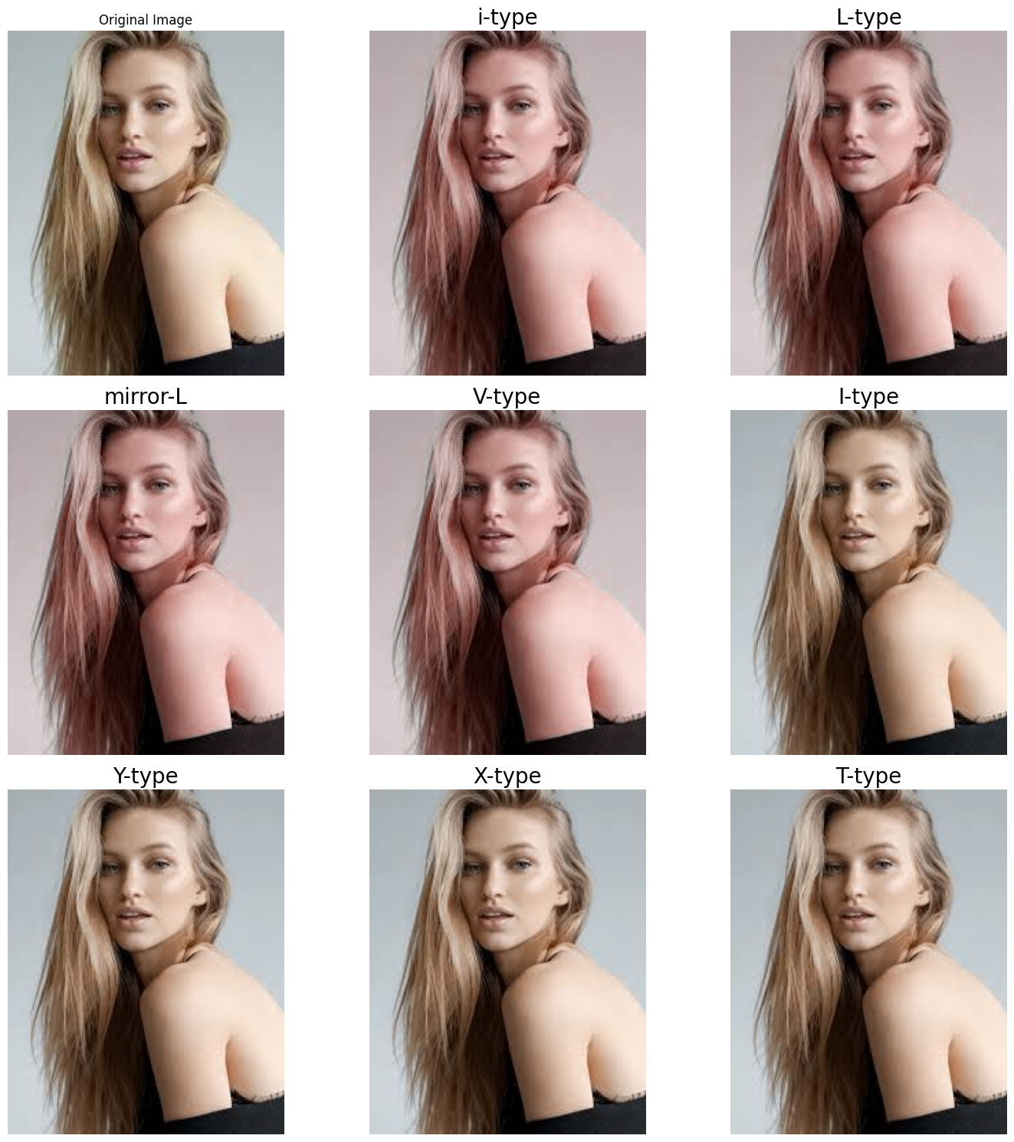
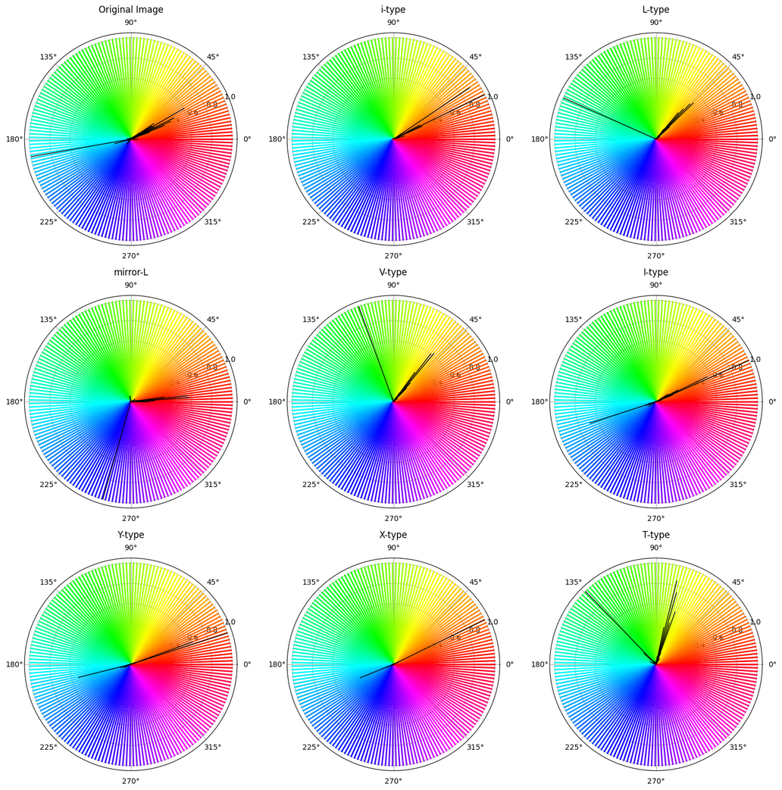
20
COLOR TRANSFER: SOURCE AND STYLE IMAGE
IIIT Hyderabad | DIP 2024

Slide 22
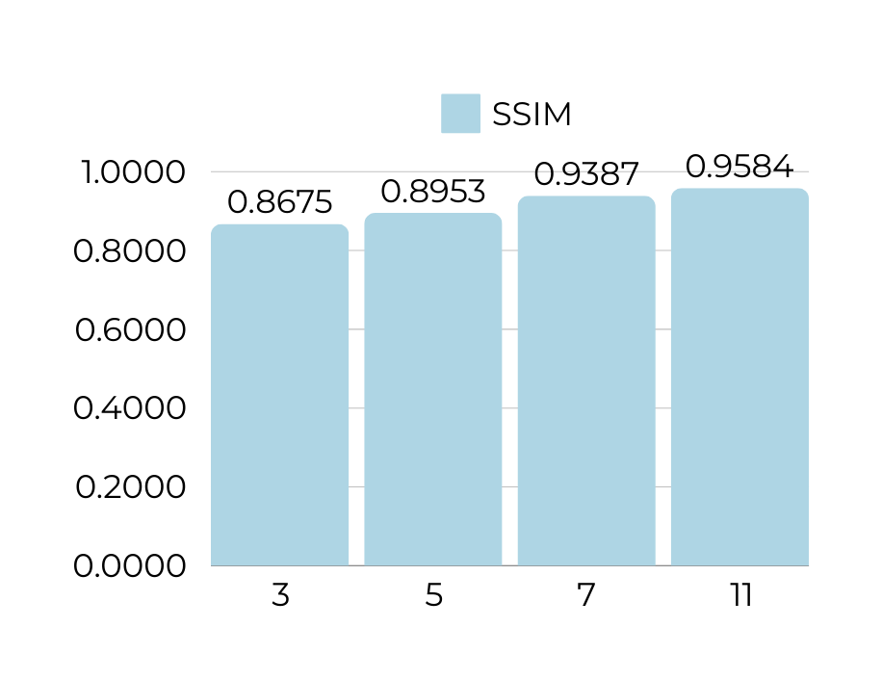
21
QUANTITATIVE METRIC: SSIM
The structural similarity index measure (SSIM) is a method for predicting the perceived quality of digital images. Used here for measuring the similarity between two images.
IIIT Hyderabad | DIP 2024
varying k (number of clusters)

Slide 23
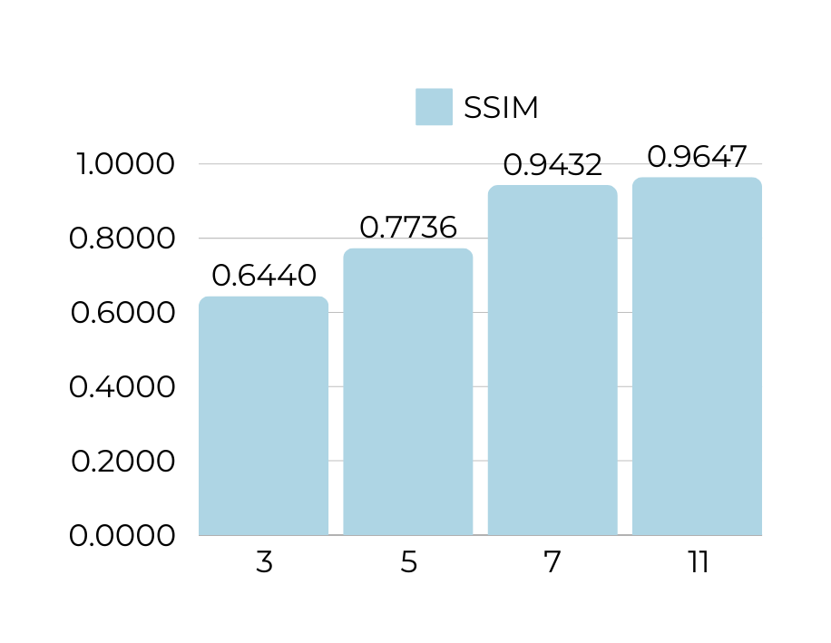
22
QUANTITATIVE METRIC: SSIM
Increasing SSIM with increasing k makes intuitive sense, because more clusters shall be able to represent the image better structurally.
IIIT Hyderabad | DIP 2024
varying k (number of clusters)

Slide 24
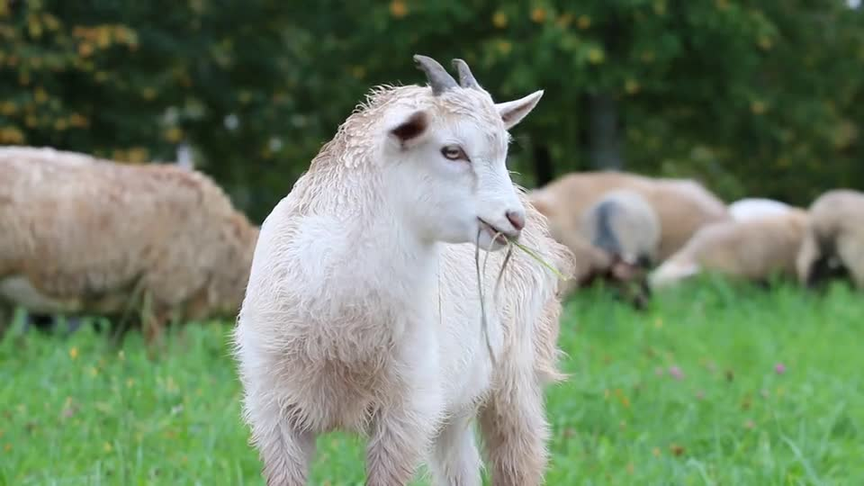
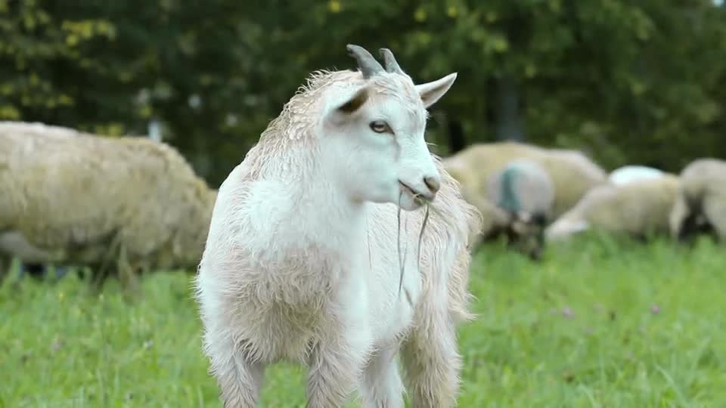
23
VIDEO HARMONIZING
Harmonized
Original

Slide 25
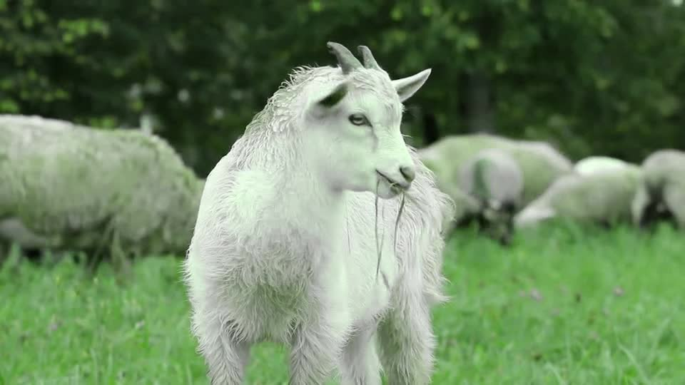
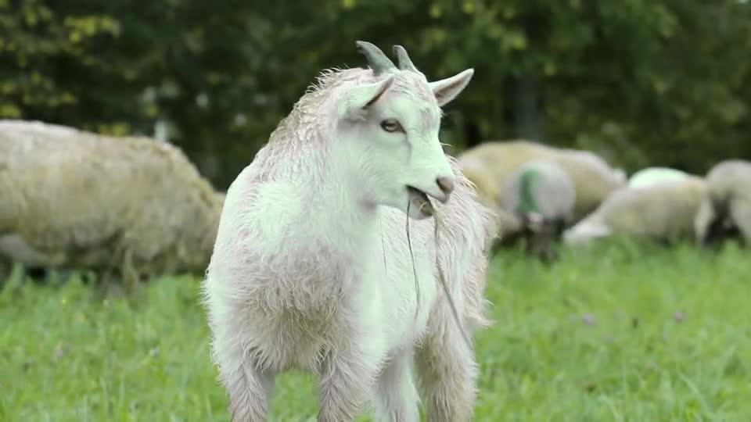
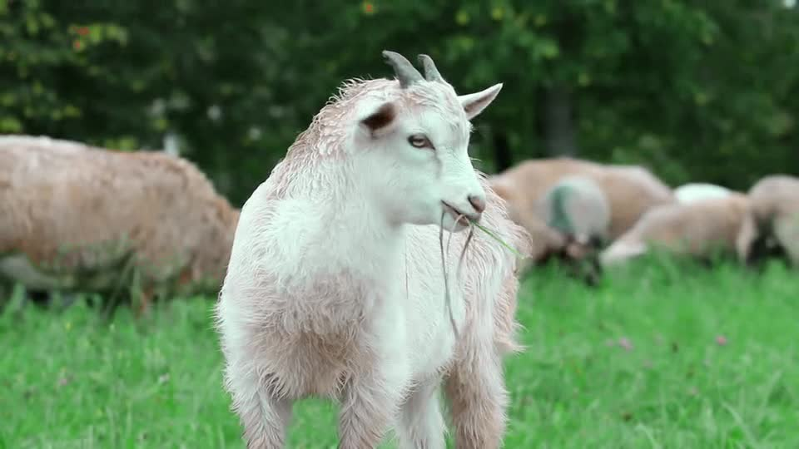
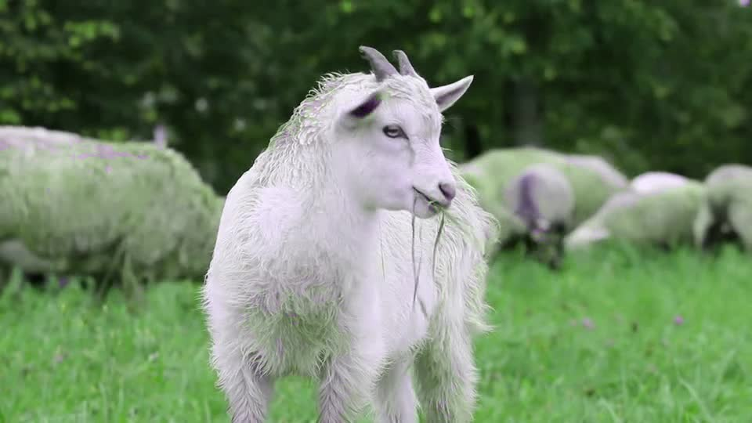
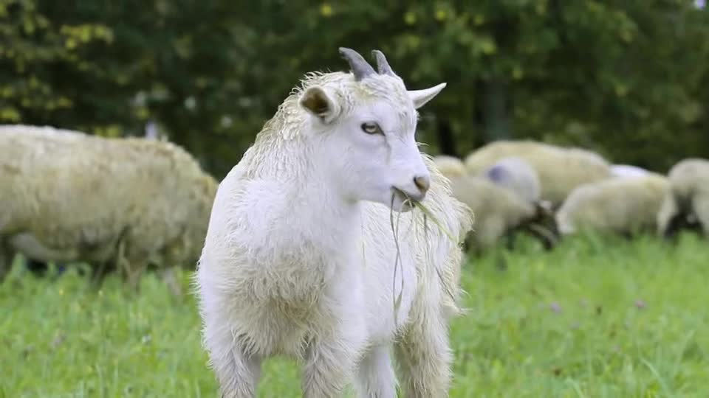
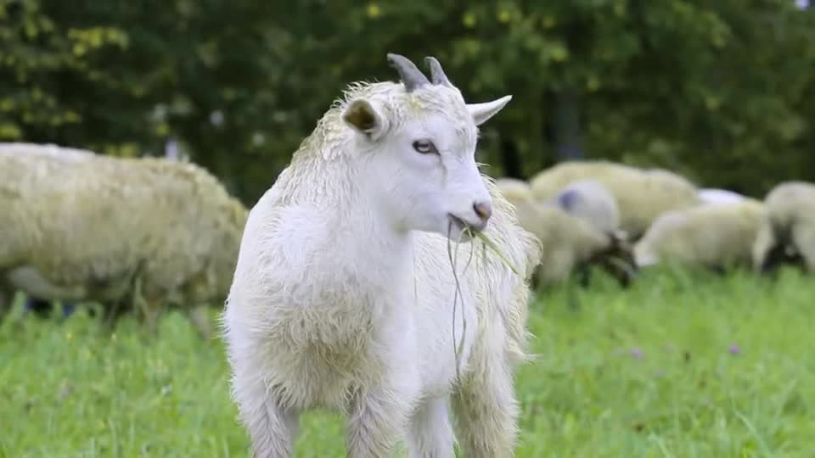
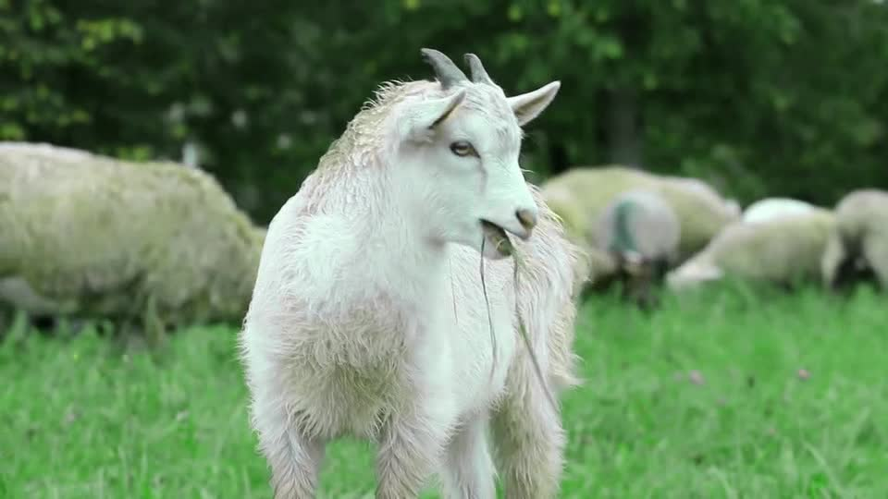
24
Original
i-type
L-type
Mirror-L
V-type
I-type
Y-type
X-type
T-type

Slide 26
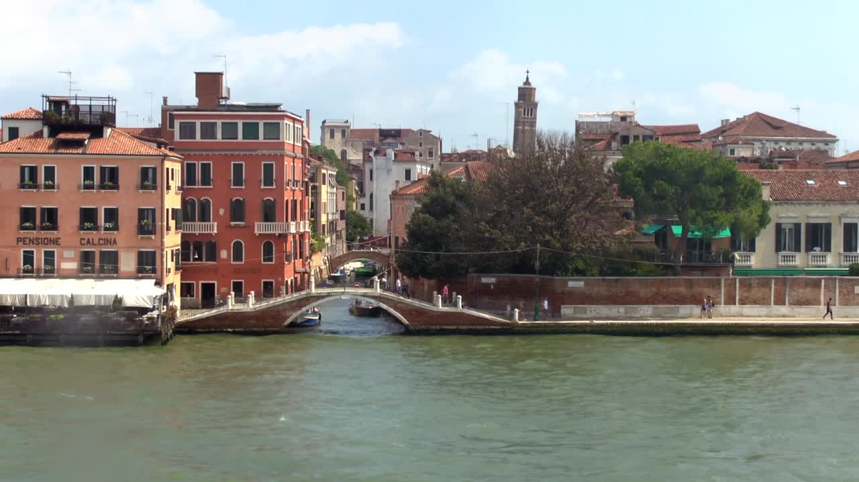
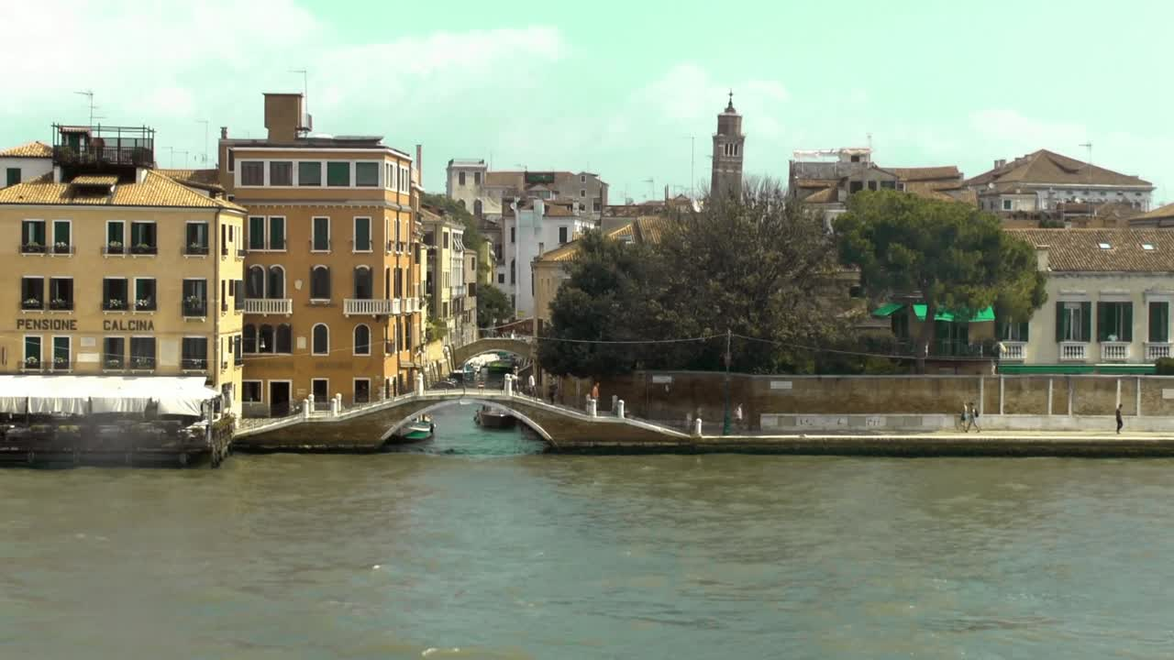
25
VIDEO HARMONIZING
Harmonized
Original

Slide 27
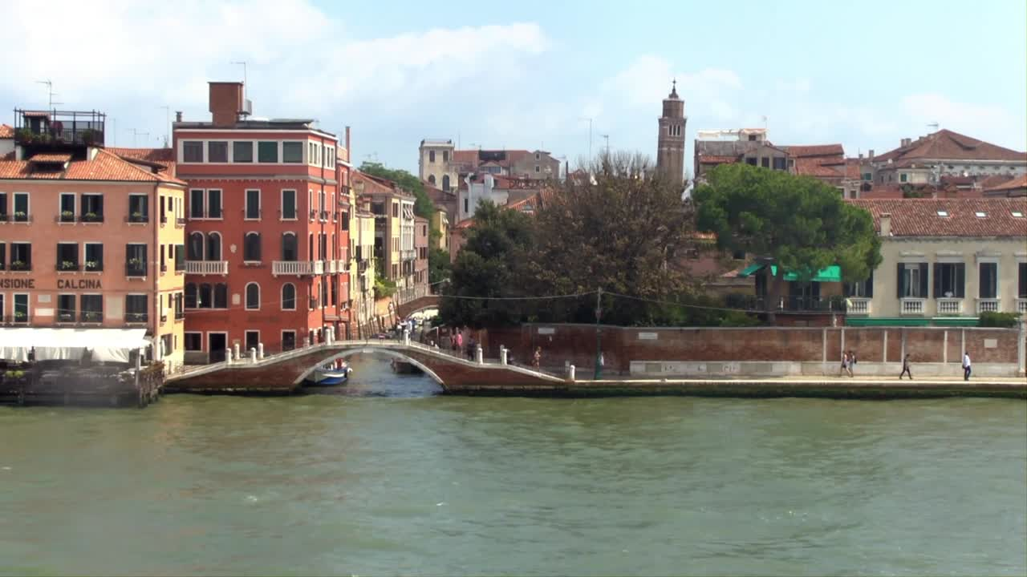
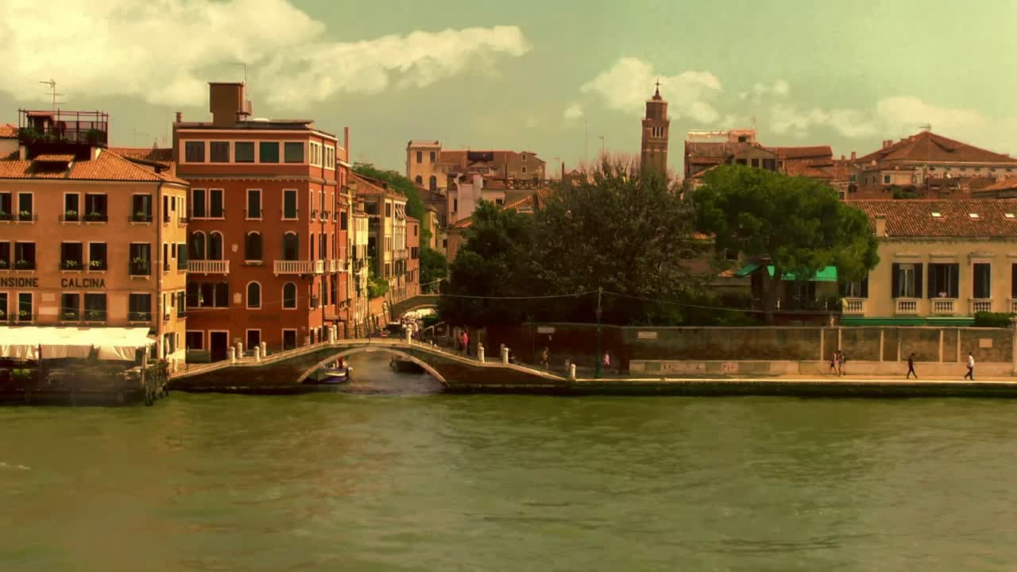
26
VIDEO COLOR GRADING
Original
Color graded

Slide 28
27
CONCLUSION AND DISCUSSION
Summing up.
The proposed methodology successfully maps style palettes onto source images while preserving perceptual coherence.
Increasing k leads to more detailed color transfer but may reduce perceptual simplicity beyond a certain threshold.
The harmonic adjustment effectively aligns hues to achieve specific aesthetic effects, with distinct results for each harmony type.
IIIT Hyderabad | DIP 2024

Slide 29
28
LIMITATIONS
Computational Complexity: The clustering-based palette extraction and harmony adjustments can be computationally intensive, especially for high-resolution images or videos. Optimizing the implementation for speed remains an area for improvement.
IIIT Hyderabad | DIP 2024
Subjectivity of Aesthetic Preferences: While harmony types and their objective measures provide a structured approach, aesthetic preferences vary widely among users. Additional personalization options, such as user-defined harmony rules, could enhance applicability.

Slide 30
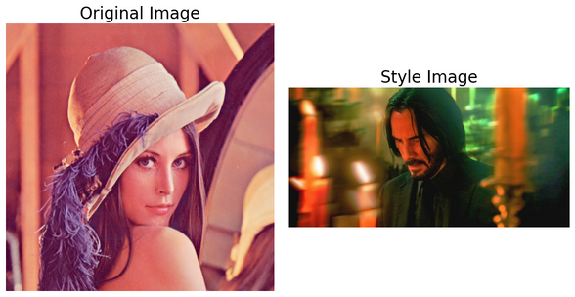
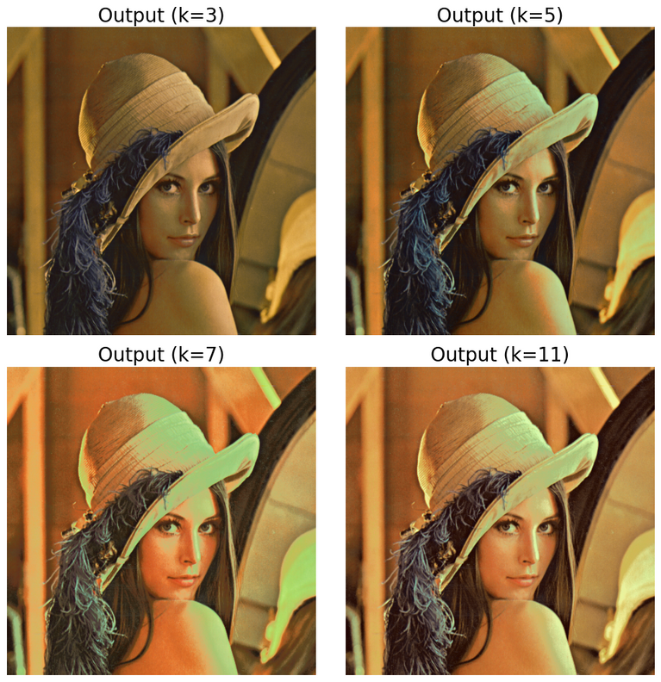
29
LIMITATIONS
Edge Cases in Color Transfer: In some cases, the transfer of highly contrasting palettes may lead to unnatural transitions or artifacts. Incorporating perceptual color models could further improve the quality of outputs.
IIIT Hyderabad | DIP 2024

Slide 31
30
FUTURE DIRECTIONS
Real-Time Applications: Developing real-time implementations of the framework for video or interactive design tools could expand its practical use cases. Techniques such as GPU acceleration or lightweight clustering algorithms may facilitate this.
Improved Perceptual Models: Incorporating advanced perceptual models, such as those based on human vision or deep learning, could enhance the naturalness and quality of color transfers.
IIIT Hyderabad | DIP 2024
Multi-Style Blending: Extending the framework to support the blending of multiple style palettes could enable more complex and creative outputs, such as gradient transitions between styles.

Slide 32
31
FUTURE DIRECTIONS
User Customization: Enhancing user control through interactive tools for parameter adjustment, harmony selection, or manual overrides could make the framework more versatile for diverse applications.
Cross-Domain Applications: Exploring the application of the methodology in domains beyond image processing, such as 3D modeling, virtual reality, or generative art, could reveal new possibilities for creative expression.
IIIT Hyderabad | DIP 2024

Slide 33
32
REFERENCES
L. Holtzschue, Understanding color : an introduction for designers. New York : Wiley, 2006. [Online]. Available: https://archive.org/search.php?query=external-identifier% 3A%22urn%3Aoclc%3Arecord%3A1036963024%22
J. Krause, Color index : [over 1,100 color combinations, CMYK and RGB formulas, for print and Web media, 2002. [Online]. Available: https://archive.org/details/ colorindexover110000krau
B. J. Meier, “Ace: A color expert system for user interface design,” Proceedings of the 1st Annual ACM SIGGRAPH Symposium on User Interface Software,. [Online]. Available: https://cs.brown.edu/∼bjm/p117-meier.pdf
D. Cohen-Or, O. Sorkine, R. Gal, T. Leyvand, and Y.-Q. Xu, “Color harmonization,” in ACM SIGGRAPH 2006 Papers, ser. SIGGRAPH ’06. New York, NY, USA: Association for Computing Machinery, 2006, p. 624–630. [Online]. Available: https://doi.org/10.1145/1179352.1141933
M. D. Buhmann, “Radial basis functions,” Acta Numerica, vol. 9, p. 1–38, 2000. [Online]. Available: https://www.cambridge.org/core/ journals/acta-numerica/article/abs/radial-basis-functions/ 3FD3A8BBC9B020FA349305142D0EB367
IIIT Hyderabad | DIP 2024

Slide 34
33
REFERENCES
6. R. P. Brent, “An algorithm with guaranteed convergence for finding the zero of a function,” 1971. [Online]. Available: https://maths-people.anu.edu.au/∼brent/pd/rpb005.pdf
7. I. Fortran, W. Press, S. Teukolsky, W. Vetterling, and B. Flannery, “Numerical recipes,” Cambridge, UK, Cambridge University Press, 01 1992.
8. D. Bora, A. Gupta, and F. Khan, “Comparing the performance of l*a*b* and hsv color spaces with respect to color image segmentation,” 06 2015. [Online]. Available: https://www.researchgate.net/publication/ 277722637 Comparing the Performance of LAB and HSV Color Spaces with Respect to Color Image Segmentation
9. R. F. M. . M. S. B. Trevor D. Canham, I. Scott MacKenzie, “The effect of perceptual optimization on color space navigability,” Proceedings of Graphics Interface 2019 - GI 2023, Article No. 14, pp. 1-10., 2019. [Online]. Available: https://www.yorku.ca/mack/gi2023.html
10. E. Chavolla, D. Zaldivar, E. Cuevas, and M. Cisneros, Color Spaces Advantages and Disadvantages in Image Color Clustering Segmentation, 01 2018, pp. 3–22. [Online]. Available: https://www.researchgate.net/publication/ 320410000 Color Spaces Advantages and Disadvantages in Image Color Clustering Segmentation
IIIT Hyderabad | DIP 2024

Slide 35
34
REFERENCES
11. Matsuda, Color Design (in Japanese), 1995.
12. M. Tokumaru, N. Muranaka, and S. Imanishi, “Color design support system considering color harmony,” in 2002 IEEE World Congress on Computational Intelligence. 2002 IEEE International Conference on Fuzzy Systems. FUZZ-IEEE’02. Proceedings (Cat. No.02CH37291), vol. 1, 2002, pp. 378–383 vol.1.
13. J. Itten, The Art of Color, 1960. [Online]. Available: https://www.irenebrination.com/files/johannes-ittens theartofcolor.pdf
14. D. Briggs and S. Westland, Itten, Johannes. Berlin, Heidelberg: Springer Berlin Heidelberg, 2014, pp. 1–3. [Online]. Available: https://doi.org/10.1007/978-3-642-27851-8 340-1
15. P. Moon and D. E. Spencer, “Geometric formulation of classical color harmony∗,” J. Opt. Soc. Am., vol. 34, no. 1, pp. 46–59, Jan 1944. [Online]. Available: https: //opg.optica.org/abstract.cfm?URI=josa-34-1-46
IIIT Hyderabad | DIP 2024

Slide 36
IIIT Hyderabad | DIP 2024
THANK YOU
Presented By : Team Mobiuz
Brahad Kokad - 2021112004
Aarnav Nagariya - 2021112017

